Slide 1
Red Agents IT Help Desk
Anna Vadella, Kwesi Kyei-fordjour, Elijah Heslop, Daniel Field, Garret Blake

Slide 2
Introductions
Anna Vadella - Scrum Master
Kwesi Kyei-fordjour - Backend
Elijah Heslop - Backend
Daniel Field - Frontend
Garret Blake - Frontend

Slide 3
Project Outline
The IT Help Desk includes a GUI interface for all user types, with each user having their own special abilities and requirements. It provides communication between users, and it has a complex backend database.
Admin
Register new users and generate ticket reports
Project Member
Raise tickets, reopen tickets, and view problem list PDFs
IT Support Team
Solve tickets and share tickets between other IT members
Report Manager
Monitor all tickets and assign unsolved and reopened tickets

Slide 4
Overview of Each Sprint
Sprint #0: Created general user stories, rough GUI design
Sprint #1: Established a clear means of communication, created team logo, created ER diagram, created first GUI demo
Sprint #2: Finished login form with login functionality and registration functionality
Sprint #3: User validation and user sessions, created database tables
Sprint #4: Implementation of emails, completed GUI design, implementation of shared + assign + solved tickets
Sprint #5: Implementation of reopen ticket functionalities, implementation of forgot password, automated report generation process, implemented PDFs

Slide 5
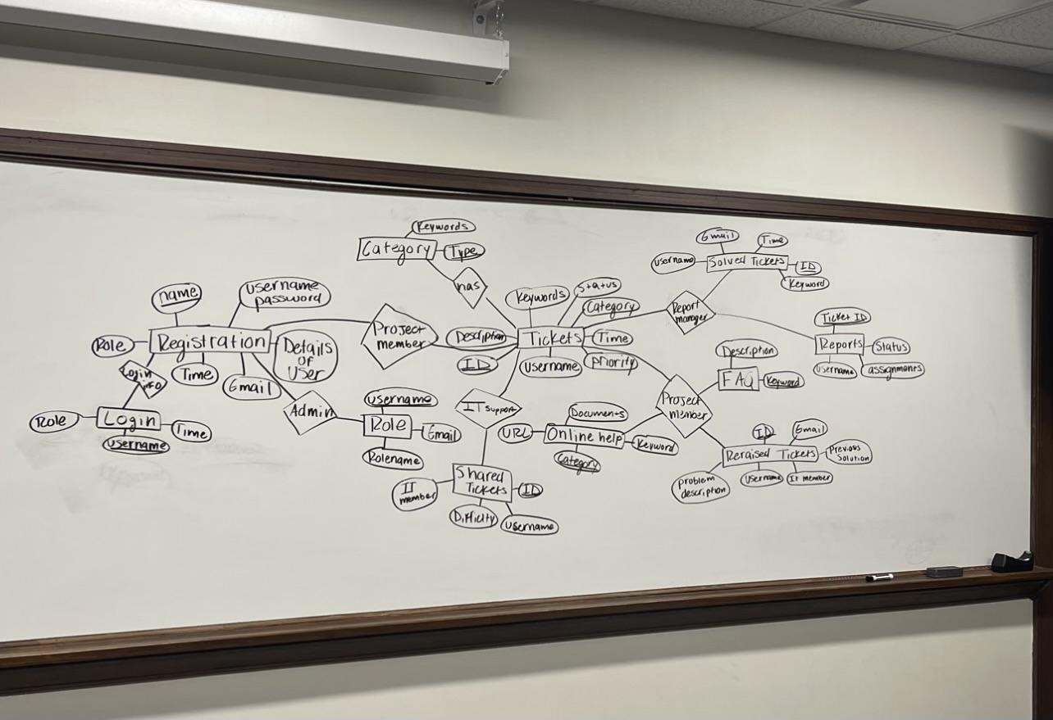
ER Diagram Rough Outline

Slide 6
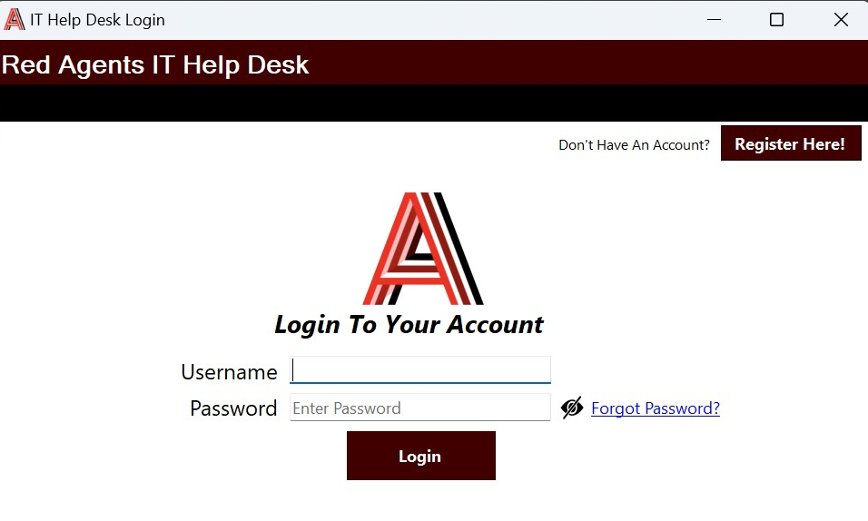
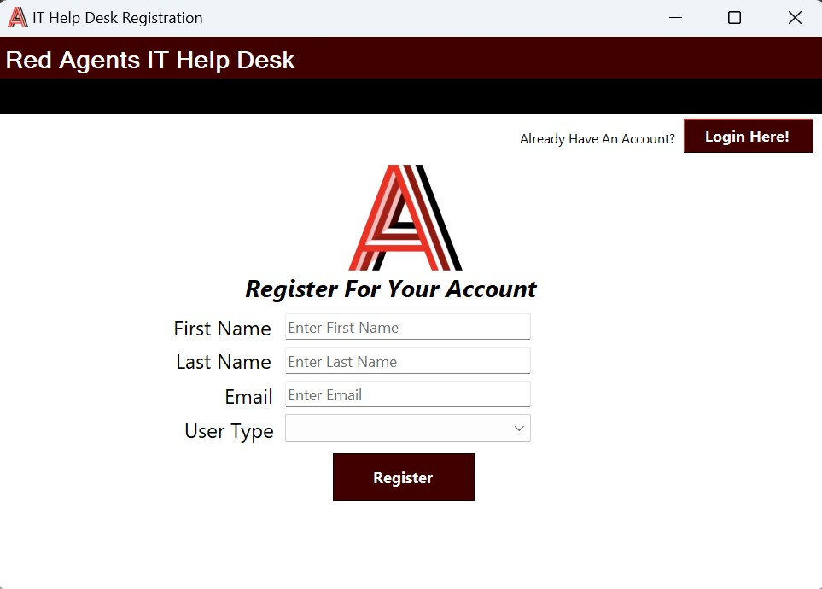
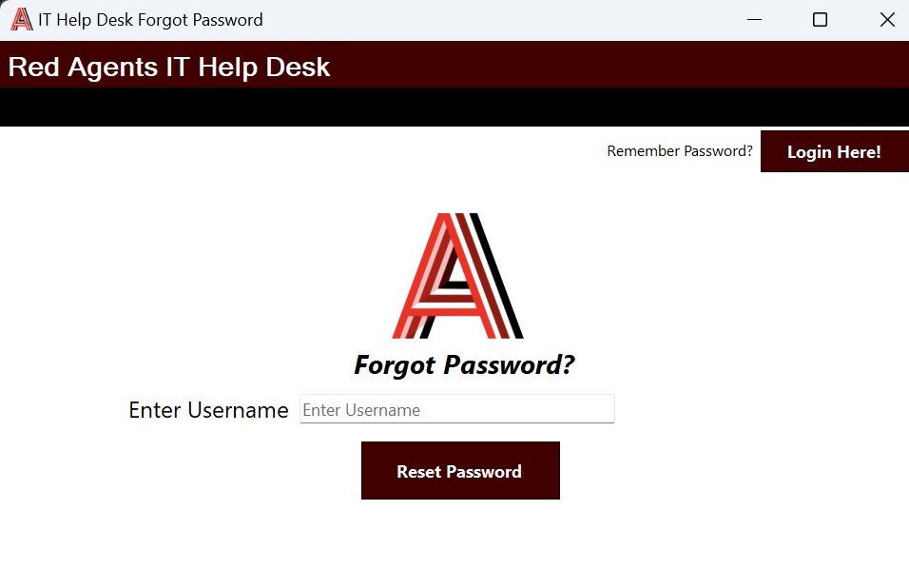
Key Functionalities of Login

Slide 7
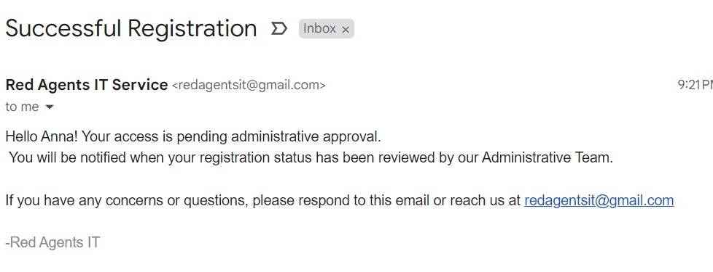
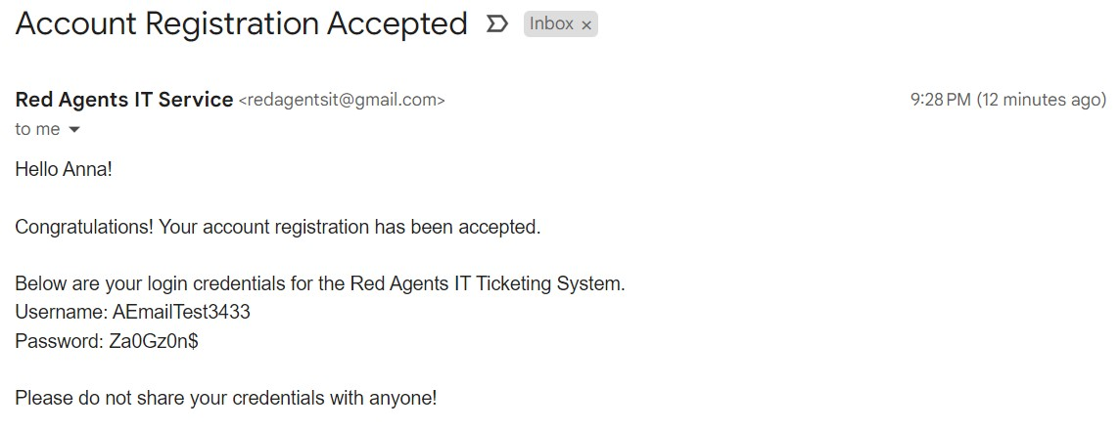
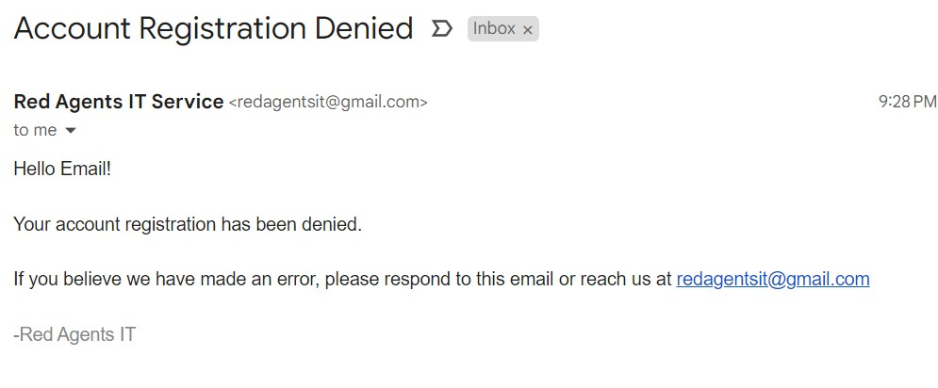
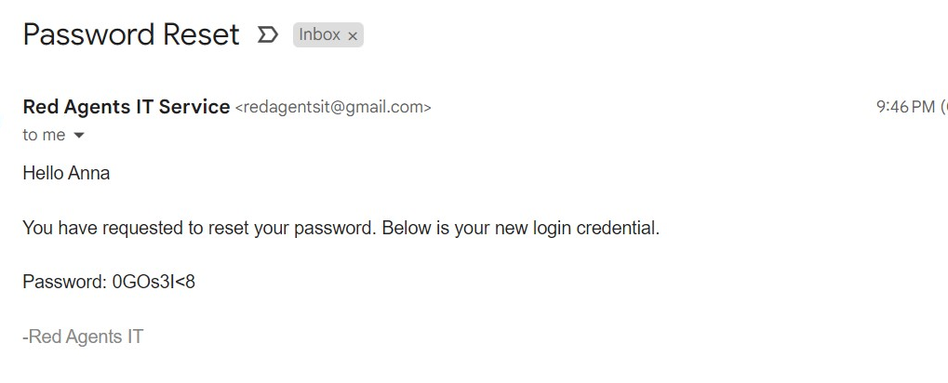
Login Email Types

Slide 8
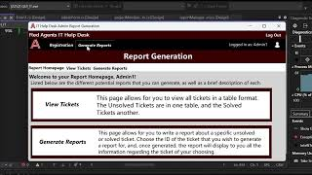
Key Functionalities of Admin

Slide 9
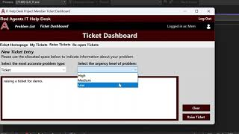
Key Functionalities of Project Member

Slide 10
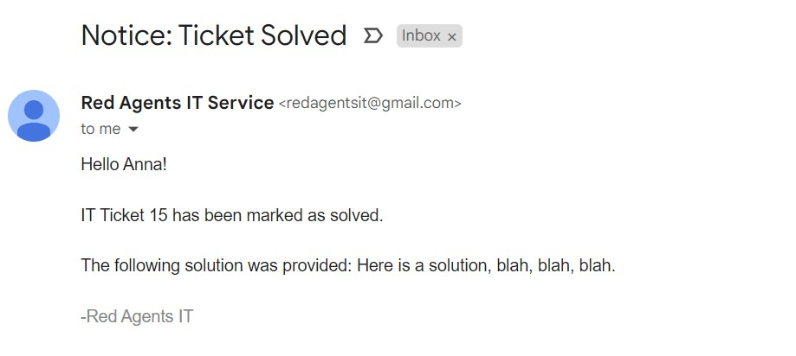
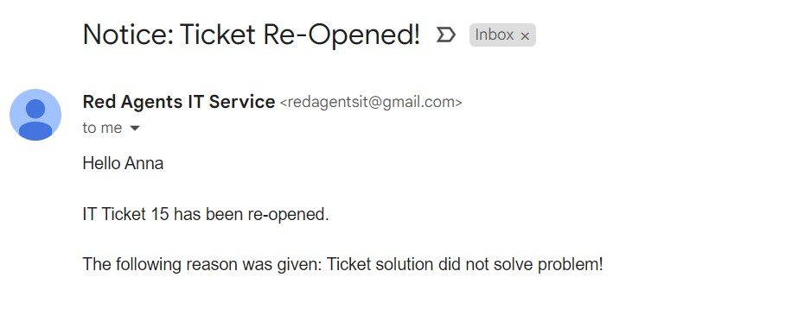
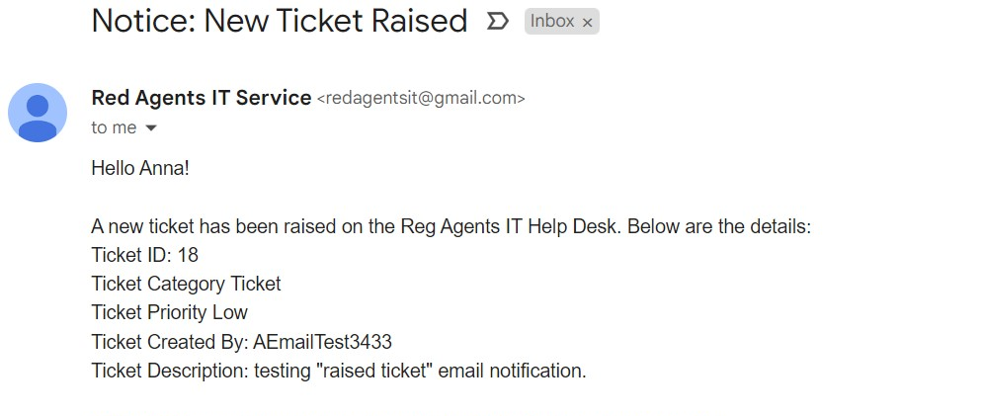
Project Member Email Types

Slide 11
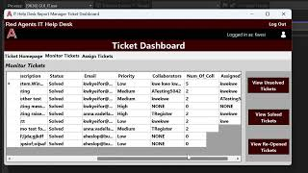
Key Functionalities of Report Manager

Slide 12
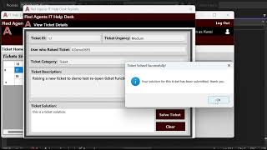
Key Functionalities of IT Support Member

Slide 13
Conclusions
Could have been better about work distribution.
The Scrum Process prepared us for success in a lot of areas.
Sprints helped a lot with progress tracking.
Diving into different areas of Scrum more thoroughly would help with the work distribution issues we encountered.
Assessing the group’s happiness metric allowed us to communicate more effectively.
Visual Studio and Github are your best friends and worst enemies.

Slide 14
Any Questions?

